Slide 1
A-View session
6.10.18
Dr. Archana Gupta
The IIS University, Jaipur
RC 1413

Slide 2
Lab Assignment
Domain | Humanities and Social Sciences
Topic of video | Mahatma Gandhi: Hind Swaraj and Critique of Modern Civilization
Link of Video | https://youtu.be/tYEjVRnBRlM
Notes:
COURSE OBJECTIVE
This course focuses on the structure, composition and role (political and non-political) of United Nations and acquaints the students with the importance of this international organization in the politics of yesteryears as well as its relevance in the contemporary times

Slide 3
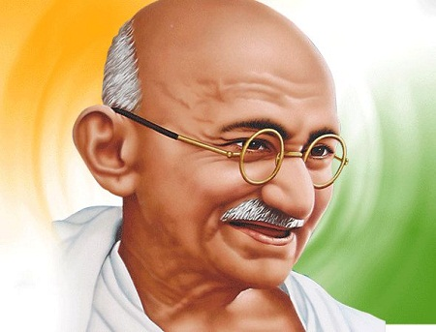
Reflection Spot
Reflection spot question- In his writings, Gandhi gave a term to his concept of Swaraj. What was that term?
Answer: Ramrajya.
Time of Reflection Spot: 3:17/ 44:24

Slide 4
Learning by Doing Activity 1
1.The Hind Swaraj is written in the form of dialogue. Between whom does this dialogue take place?
An editor and a reader
A teacher and a student
A mentor and protege
Answer: An editor and a reader
Constructive feedback: The reader, in Gandhi's thought represents 'Indian School of Violence', as Gandhi put it or the revolutionaries who were ready to use the violent methods, and the editor is Gandhi himself, who is giving an alternative in his own ideas.

Slide 5
Learning by Doing Activity 2
2. Gandhi clarifies the meaning of Swaraj as:
Self rule
autonomy
dominion
Answer: Self rule
Constructive Feedback: Gandhi describes his concept of Swaraj as self rule in the sense of self government and self improvement both whereas autonomy and dominion are only in political contexts.

