Slide 1
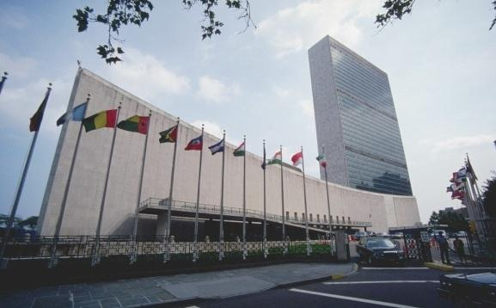
UNITED NATIONS

Slide 2
COURSE OBJECTIVE
This course focuses on the structure, composition and role (political and non-political) of United Nations and acquaints the students with the importance of this international organization in the politics of yesteryears as well as its relevance in the contemporary times
Notes:
COURSE OBJECTIVE
This course focuses on the structure, composition and role (political and non-political) of United Nations and acquaints the students with the importance of this international organization in the politics of yesteryears as well as its relevance in the contemporary times

Slide 3
Course outline
Background
The General Assembly
The Security Council
The ECOSOC
The Trusteeship Council
The Secretary General

Slide 4
ASSESSMENT SCHEME
SCHEME OF ASSESSMENT (MID SEMESTER)
Test | Home Assignment | Teacher interaction | Attendance | Total
15 marks | 5 marks | 5 marks | 5 marks | 30 marks
SCHEME OF ASSESSMENT (SEMESTER END)
Report Presentation | Viva Voce | Total
40 marks | 30 marks | 70 marks

